Slide 1
Bellabeat:
Understanding user activity
Julien Smith
Last updated: June 5th, 2025

Slide 2
Analyze the relationship between physical activity and weight log trends to help Bellabeat personalize fitness guidance and support wellness goals for users.
Objective:

Slide 3
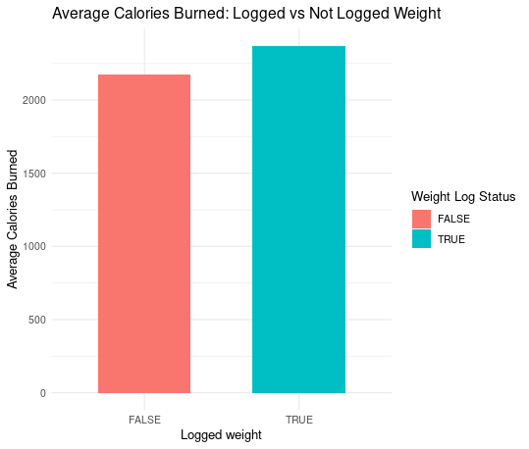
Research was conducted based on the activity levels of those who logged their weight and those who didn’t.
On average, those who logged their weight burned a higher amount of calories compared to those who didn’t
However, the sample size for entries of those who logged their weight (33) is much smaller than those who didn’t (457)

Slide 4
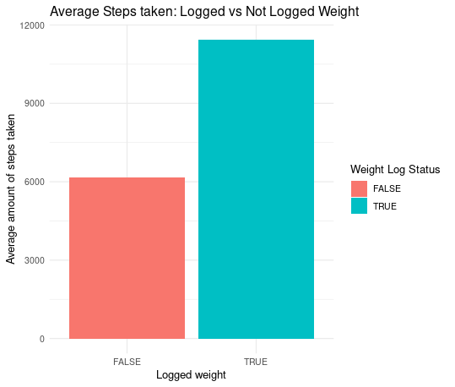
Similarly, users who logged their weight tended to walk more on average
We can infer that users who log their weight are more active based on the amount of steps taken and calories burned.

Slide 5
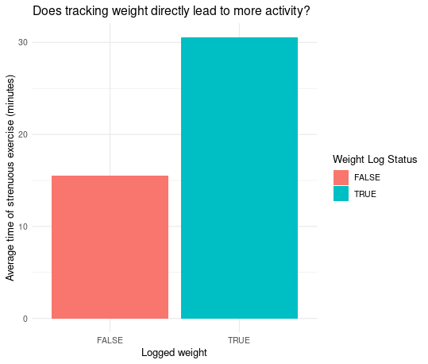
Users who logged their weight were engaged in longer sessions of intense exercise, twice as much than those who didn’t
Does weight logging behavior tie into how committed a user is to their fitness plan?

Slide 6
Conclusion
Based on our findings, we can conclude that users who logged their weight were overall more physically active for longer durations of time.
Bellabeat could improve customer engagement by advocating for users to log their weight after workouts.
This could be enforced through in-app prompts after workouts, such as offering small rewards for consistent weight-logging.
This aligns with Bellabeat mission of supporting wellness goals through promoting physical activity.

Slide 7
Thank you

